Slide 1
Interaction Analysis for Multi-Loop Control

Slide 2
Multivariable Process Control
Industrial Processes
multivariable (multiple inputs influence same output) and exhibit strong interaction among the variables
Conventional Control scheme
Multiple Single Input Single Output PID controllers used for controlling plant (Multi-Loop Control)
Consequences
Loop Interactions
Lack of coordination between different PID loops
Neighboring PID loops can co-operate with each other or end up opposing / disturbing each other

Slide 3
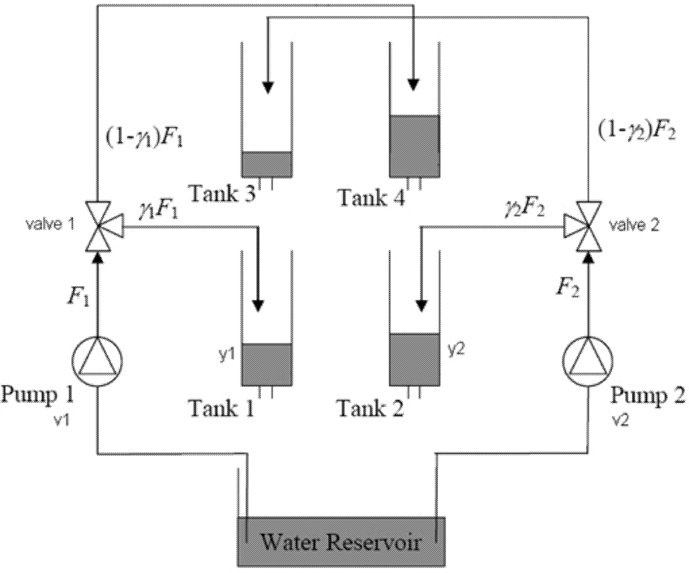

Quadruple Tank
$$y_{1}\left(s\right)=g11\left(s\right)u_{1}\left(s\right)+g12\left(s\right)u_{2}\left(s\right)$$
$$y_{2}\left(s\right)=g21\left(s\right)u_{1}\left(s\right)+g_22\left(s\right)u_{2}(s)$$

Slide 4
Block Diagram : Quad Tank

Slide 5
Loop Interactions : Quad Tank

Slide 6
Shell Control Problem

Slide 7
Shell Control Problem
Control Scheme 1
PID-1: (y1) Top End Point - (u1) Top Draw
PID-2: (y2) Side Endpoint - (u2) Side Draw
PID-3: (y3) Bottom Reflux Temperature – (u3) Bottom Reflux Duty
Control Scheme 2
PID-1: (y2) Side End Point - (u1) Top Draw
PID-2: (y1) Top Endpoint - (u2) Side Draw
PID-3: (y3) Bottom Reflux Temperature –(u3) Bottom Reflux Duty
How to examine above options systematically and reach a decision ?

Slide 8
Tennesse Eastman Problem
Primary Controlled Variable: G conc in Product and Product flow rate

Slide 9
Input - Output Variables

Slide 10
Loop Interactions
Large loop interactions :
can lead to poor quality of control due to lack of coordination among PID controllers
Solution strategy:
Choose controller pairing with minimal interactions
De-tune the controllers to minimize loop interactions
Design multi-variable controllers, which simultaneously Change all inputs by considering errors in all the outputs

Slide 11
Quadruple Tank process
LC
LT
LT
LC

Slide 12
Block Diagram : Quad Tank

Slide 13
Loop Interactions : Quad Tank

Slide 14
Interaction Analysis
Assume a loop pairing say y₁-u₁ and perform the following experiments
With all loops open, make a step change in u₁ to u₁+ Δu and measure the change in output Δy₁.
We will term this as a direct effect.
With all loops except the u₁-y₁ loop closed, repeat the same change in u₁.
There will be change in y₁ because of the direct effect but also there will be a retaliatory effect because u₂ changes to keep y₂ constant.
We will term this change as Δy₁+Δy_{1r}

Slide 15
Interaction Analysis
Ratio of these two terms can be defined as λ₁₁ (for the y1-u1 pairing) as
λ₁₁ = Δy₁/( Δy₁+Δy_{1r})
This is called relative gain
Compute relative gain for each assumed input/output pairing
Depending on the values of this index for various assumed loop pairings (step 1), decision can be taken on the final loop pairing.
This decision making is based on steady state analysis only.

Slide 16
Relative Gain Array (RGA)

Slide 17
Calculation of RGA

Slide 18
Calculation of RGA

Slide 19
Calculation of RGA

Slide 20
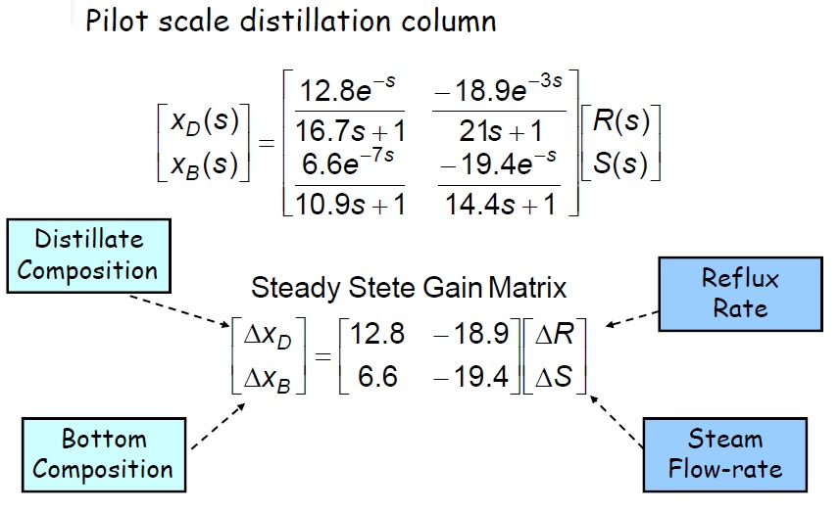
Wood-Berry Column

Slide 21
Wood-Berry Column

Slide 22
Wood-Berry Column
Multi-Loop PID Control
Change in closed loop behavior due to loop interactions

Slide 23
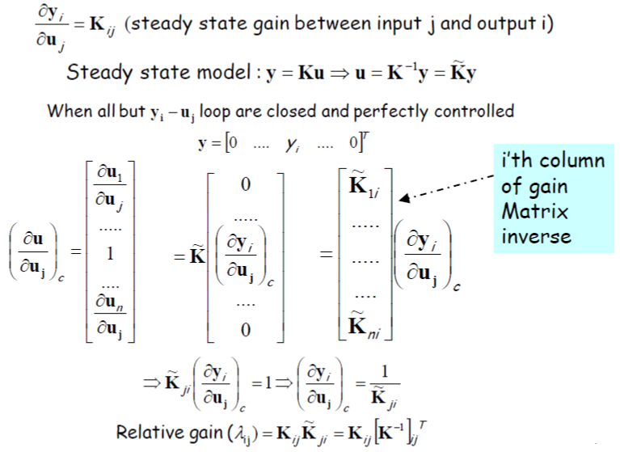
RGA calculation for MIMO Process

Slide 24
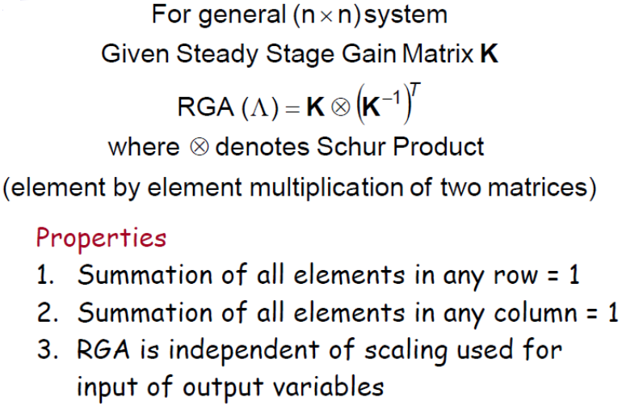
MIMO RGA Calculation

Slide 25
RGA for Blending Tank
Process: Blending of two process streams to get desired composition of A in the product.
Control objective : m,x by manipulating m1 and m2
Desired value for m and x is m* and x*. Find RGA
m1, Pure A
m, x
m2, Pure B

Slide 26
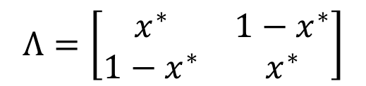
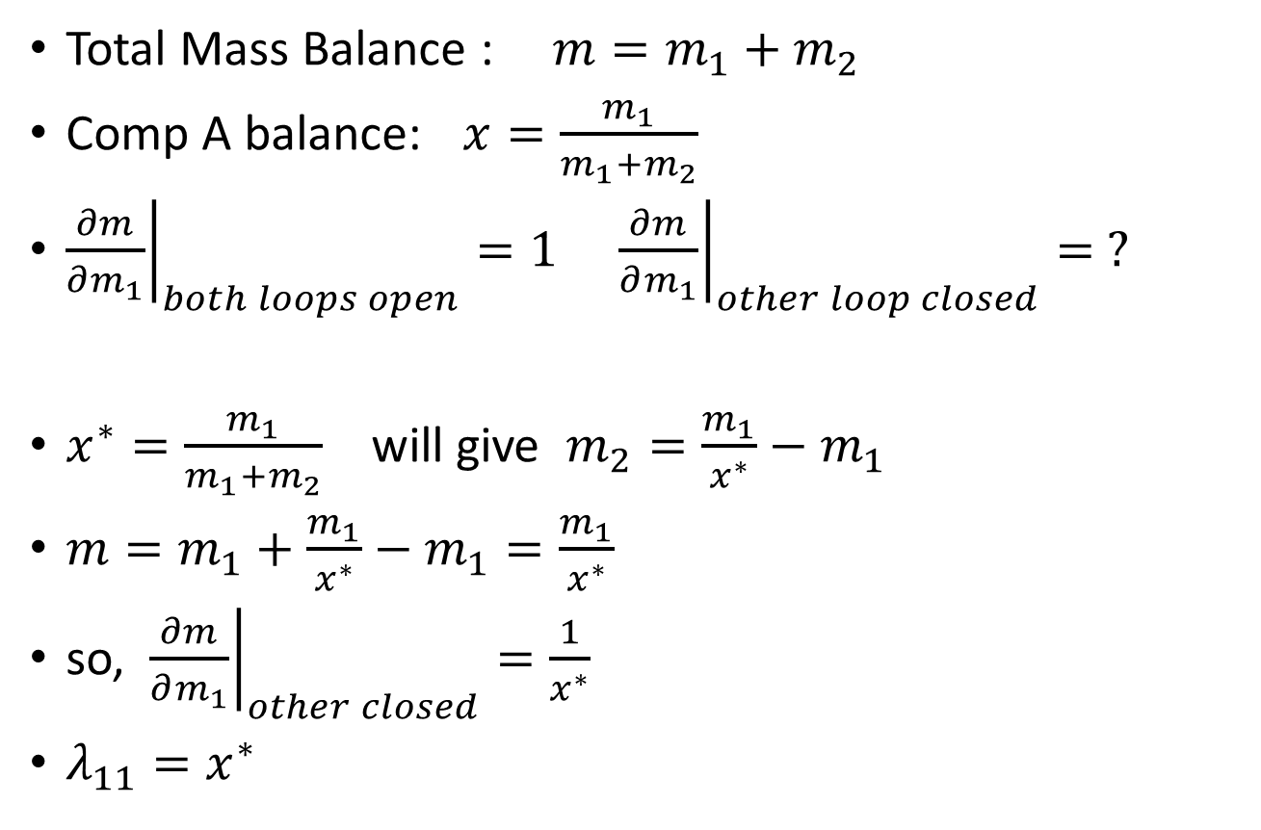
RGA for Blending Tank
Total Mass Balance : $m=m_{1}+m_{2}$
Comp A balance: $x=\frac{m_{1}}{m_{1}+m_{2}}$
${\left.\frac{∂m}{∂m_{1}}\right|}_{both loops open}=1$ ${\left.\frac{∂m}{∂m_{1}}\right|}_{other loop closed}= ?$
$x^{∗}=\frac{m_{1}}{m_{1}+m_{2}}$ will give $m_{2}=\frac{m_{1}}{x^{∗}}−m_{1}$
$m=m_{1}+\frac{m_{1}}{x^{∗}}−m_{1}=\frac{m_{1}}{x^{∗}}$
so, ${\left.\frac{∂m}{∂m_{1}}\right|}_{other closed}=\frac{1}{x^{∗}}$
$λ_{11}=x^{∗}$
$$Λ=\left[\begin{matrix}x^{∗} & 1−x^{∗} \\ 1−x^{∗} & x^{∗}\end{matrix}\right]$$

Slide 27
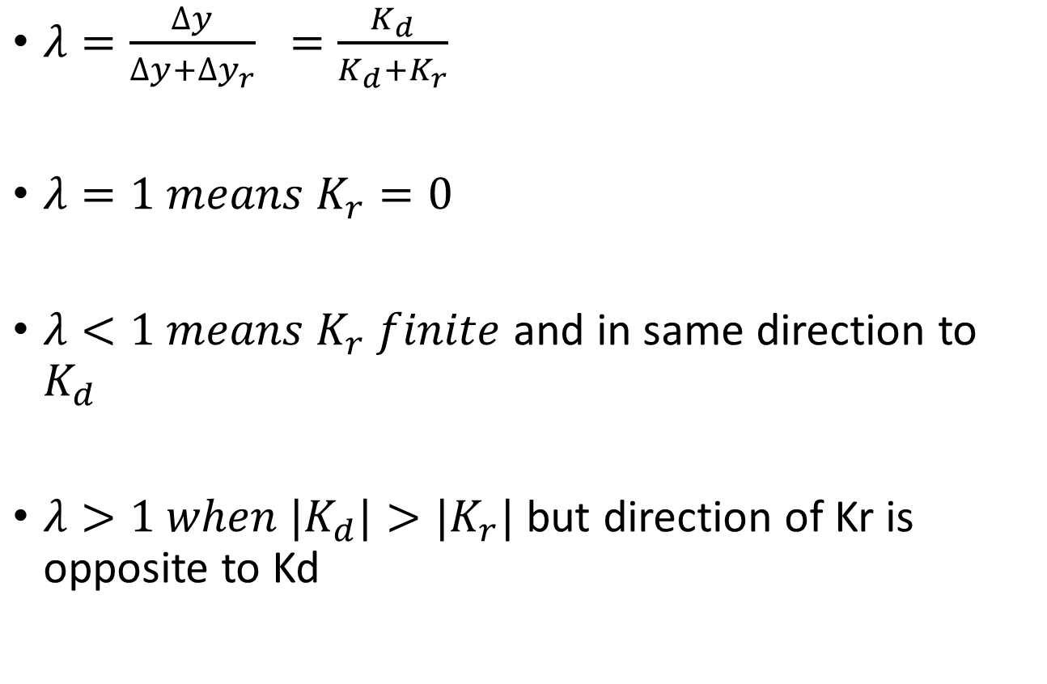
Analysis of RGA
$λ=\frac{∆y}{∆y+∆y_{r}} =\frac{K_{d}}{K_{d}+K_{r}}$
$λ=1 means K_{r}=0$
$λ<1 means K_{r} finite$ and in same direction to $K_{d}$
$λ>1 when {|K}_{d}|>{|K}_{r}|$ but direction of Kr is opposite to Kd

Slide 28
Analysis of RGA
If λ₁₁ =1 ⇒ retaliatory action is not present. So assumed loop pairing is correct because there is no interaction from the other loop.
If 0 < λ₁₁ < 1 ⇒ retaliatory action is comparable to the direct action but is in the same direction. The assumed loop pairing may be chosen only if the index is closer to 1 (say 0.8).
If λ₁₁ =0 ⇒ Retaliatory action is much greater than the direct action. The assumed loop pairing is incorrect. The loop pairing u₁-y₂ is preferable

Slide 29
Analysis of RGA
If λ₁₁ > 1 ⇒ Retaliatory action is in opposite direction to the direct action but is smaller in magnitude than the direct. The assumed loop pairing may be chosen only if the index is close to 1.
If λ11 < 0, Retaliatory effect is larger and opposite in direction to the main effect. Do not choose this loop pairing.

Slide 30
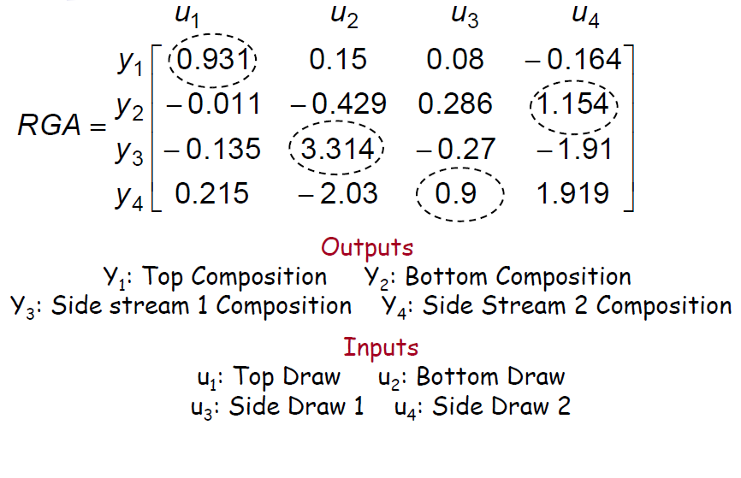
Suggested Loop Pairing
Refinery Distillation Column

Slide 31
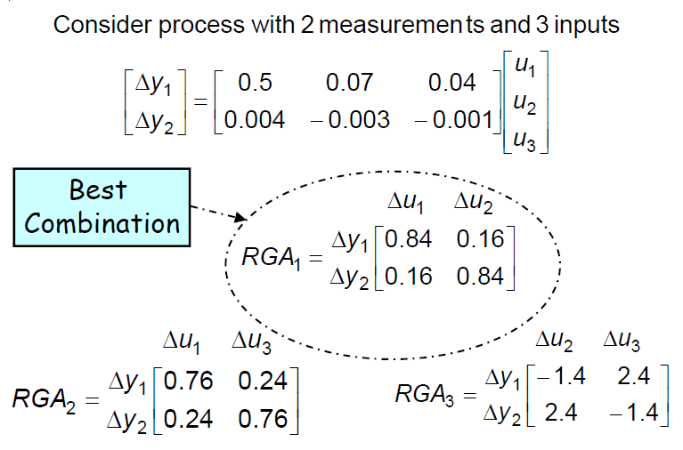
RGA analysis : Non-square System

Slide 32
Singular Value Analysis
Powerful analytical tool for
Selection of controlled, measured and manipulated variables
Determination of best multi-loop configuration
Evaluation of robustness (insensitivity to changes in plant behavior) of a control scheme

Slide 33
Singular Value Analysis
Non-square systems (number of inputs not equal to number of outputs)
SVA can be used to find a square subset with least difficulties in control
Larger condition number implies difficulties in controlling a system
Among multiple possibilities, choose subset with minimum condition number
Limitation: Singular values are dependent on scaling of input and output variables

Slide 34
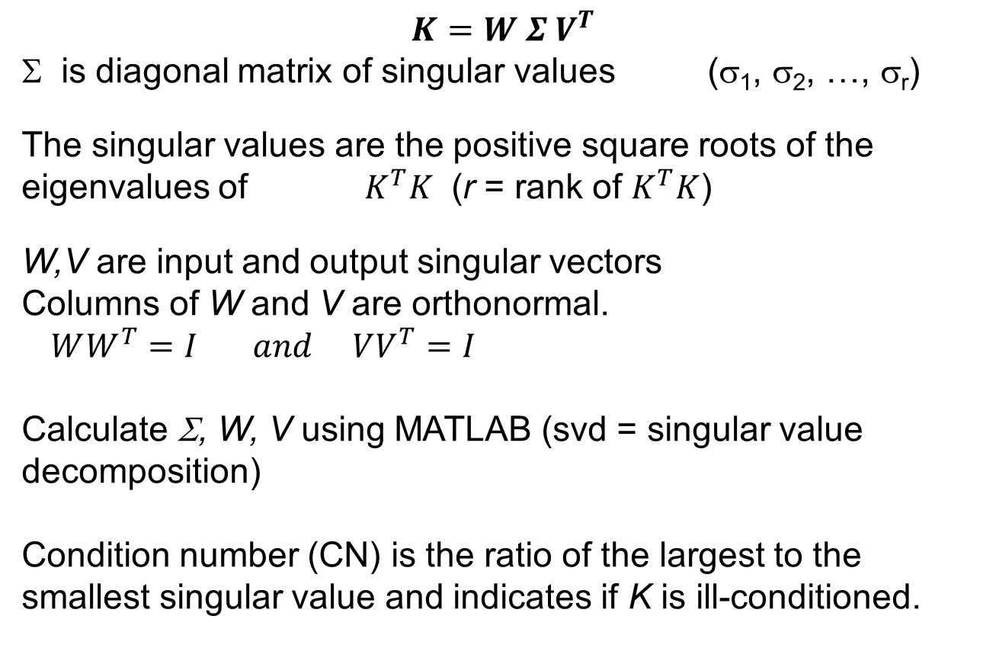
Singular Value Decomposition
$$K=W Σ V^{T}$$
Σ is diagonal matrix of singular values (σ₁, σ₂, …, σ_{r})
The singular values are the positive square roots of the eigenvalues of $K^{T}K$ (r = rank of $K^{T}K$)
W,V are input and output singular vectors
Columns of W and V are orthonormal.
$WW^{T}=I and VV^{T}=I$
Calculate Σ, W, V using MATLAB (svd = singular value decomposition)
Condition number (CN) is the ratio of the largest to the smallest singular value and indicates if K is ill-conditioned.

Slide 35
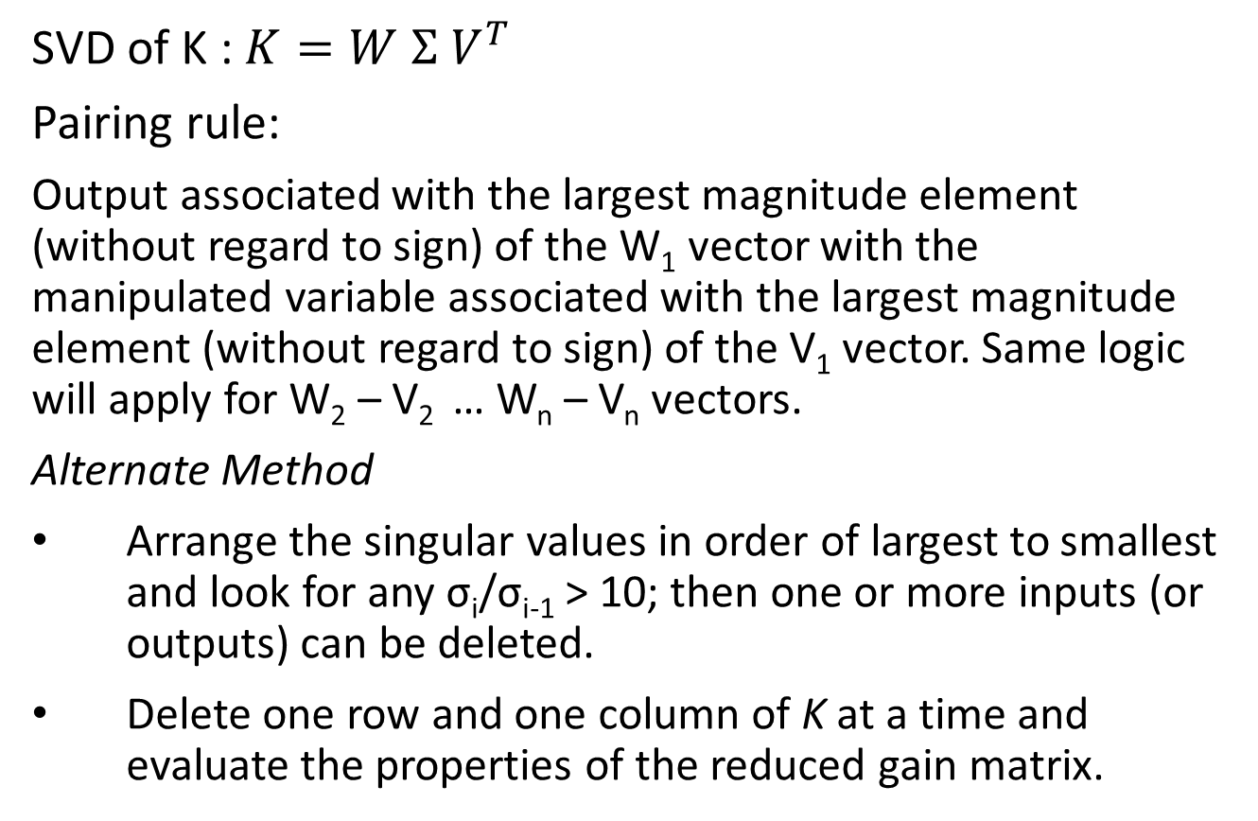
Singular Value Analysis
SVD of K : $K=W Σ V^{T}$
Pairing rule:
Output associated with the largest magnitude element (without regard to sign) of the W₁ vector with the manipulated variable associated with the largest magnitude element (without regard to sign) of the V₁ vector. Same logic will apply for W₂ – V₂ … W_{n} – V_{n} vectors.
Alternate Method
Arrange the singular values in order of largest to smallest and look for any σ_{i}/σ_{i-1} > 10; then one or more inputs (or outputs) can be deleted.
Delete one row and one column of K at a time and evaluate the properties of the reduced gain matrix.

Slide 36
Example
RGA=

Slide 37
Quadruple Tank Process
Schematic of Quadruple Tank Process

Slide 38
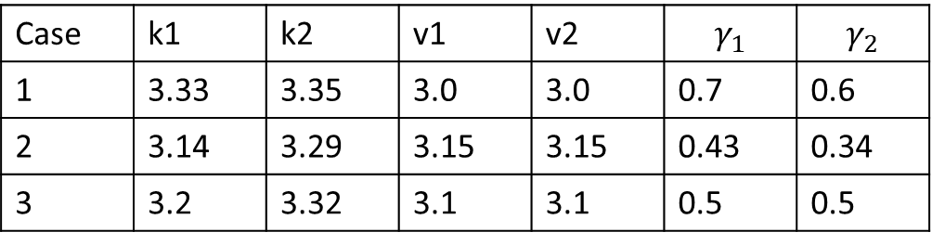
Quadruple Tank problem
Control Objective
Both the levels of tank1 and tank2 should be controlled by manipulating voltages to the pumps.
Data for simulation:
A₁, A₃ = 28 cm²
A₂, A₄ = 32 cm²
a₁, a₃ = 0.071 cm²
a₂, a₄ = 0.057 cm²
Case | k1 | k2 | v1 | v2 | $$γ_{1}$$ | $$γ_{2}$$
1 | 3.33 | 3.35 | 3.0 | 3.0 | 0.7 | 0.6
2 | 3.14 | 3.29 | 3.15 | 3.15 | 0.43 | 0.34
3 | 3.2 | 3.32 | 3.1 | 3.1 | 0.5 | 0.5

Slide 39
Block Diagram : Quad Tank

Slide 40
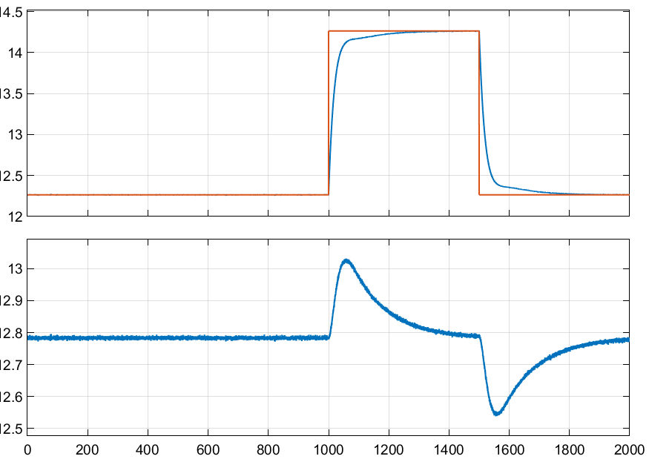
Quad Tank : Case 1

Slide 41
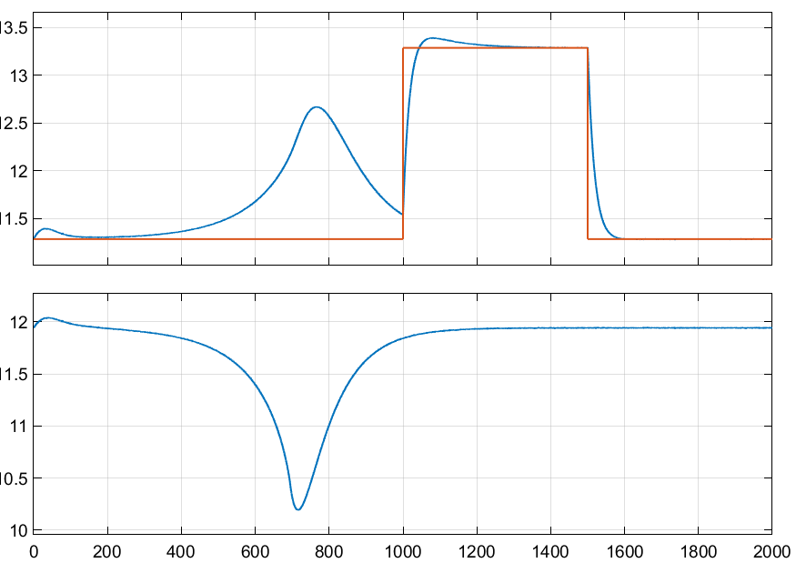
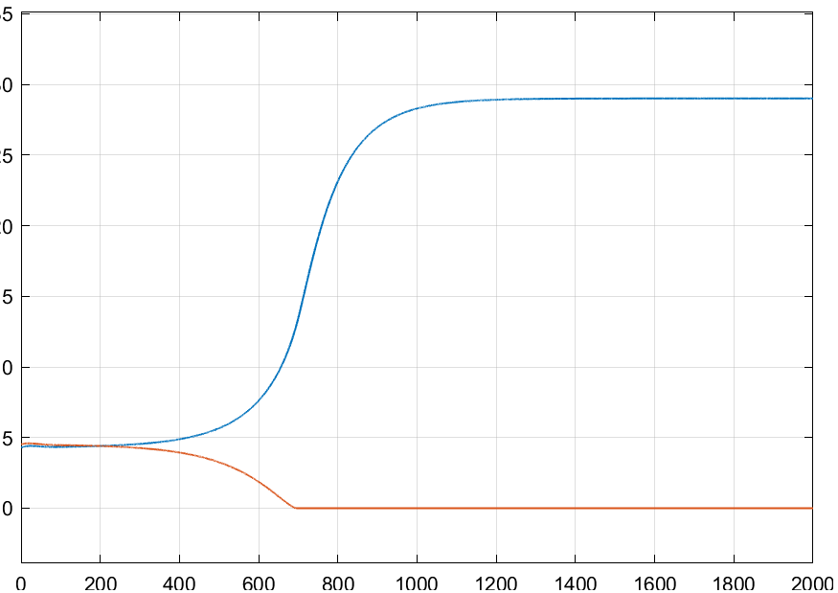
Quad Tank: Case 2

Slide 42
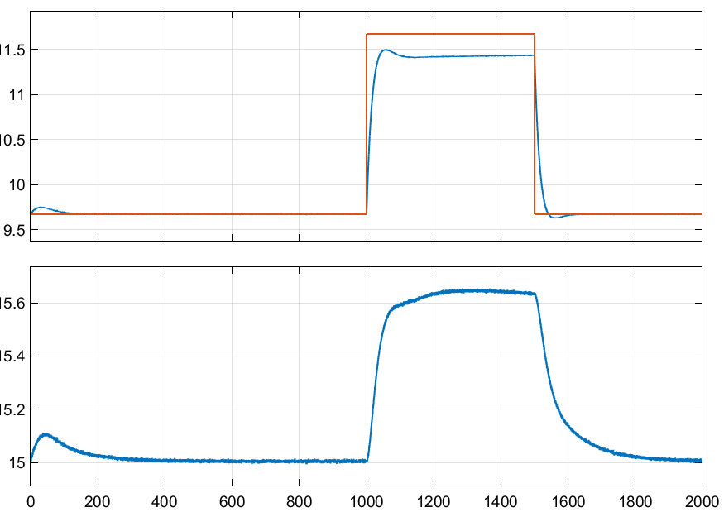
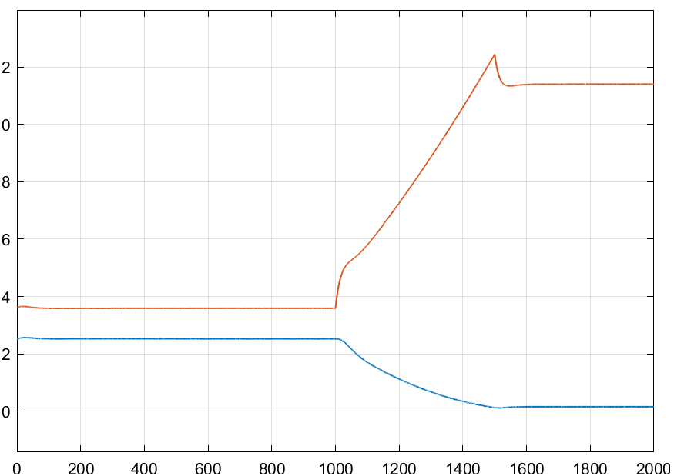
Quad Tank: Case 3

Slide 43
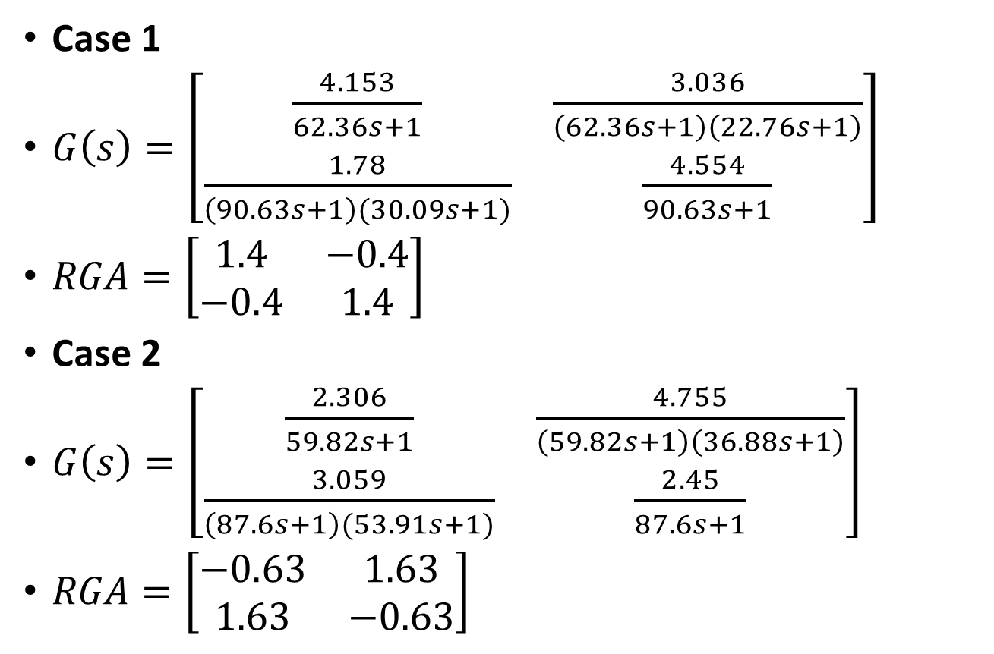
Quad Tank
Case 1
$G\left(s\right)=\left[\begin{matrix}\frac{4.153}{62.36s+1} & \frac{3.036}{\left(62.36s+1\right)\left(22.76s+1\right)} \\ \frac{1.78}{\left(90.63s+1\right)(30.09s+1)} & \frac{4.554}{90.63s+1}\end{matrix}\right]$
$RGA=\left[\begin{matrix}1.4 & −0.4 \\ −0.4 & 1.4\end{matrix}\right]$
Case 2
$G\left(s\right)=\left[\begin{matrix}\frac{2.306}{59.82s+1} & \frac{4.755}{\left(59.82s+1\right)\left(36.88s+1\right)} \\ \frac{3.059}{\left(87.6s+1\right)(53.91s+1)} & \frac{2.45}{87.6s+1}\end{matrix}\right]$
$RGA=\left[\begin{matrix}−0.63 & 1.63 \\ 1.63 & −0.63\end{matrix}\right]$

Slide 44
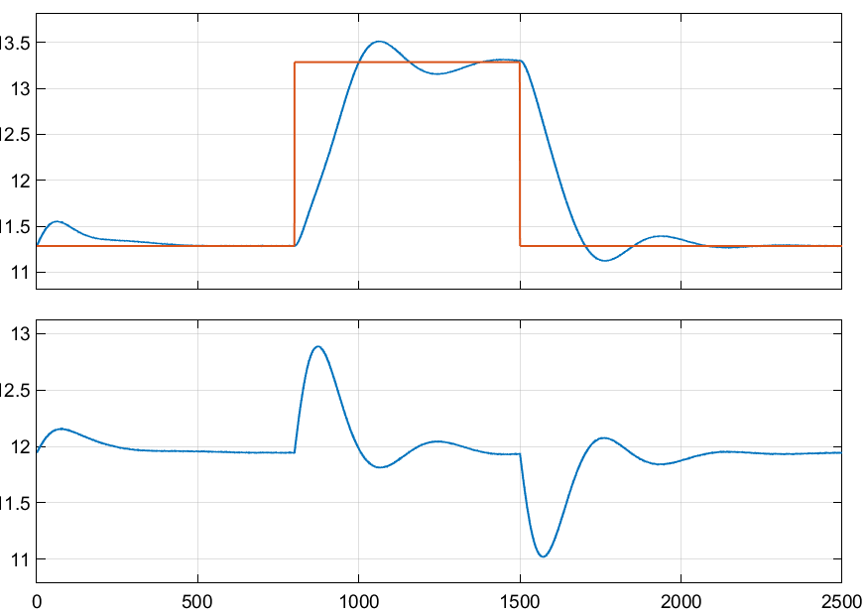
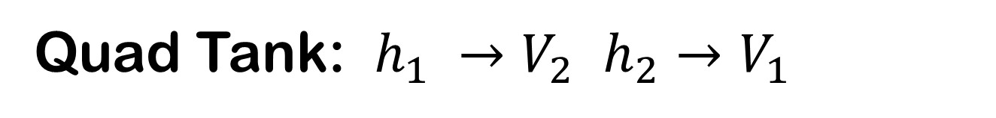
Quad Tank: $h_{1} →V_{2}$ $h_{2}→V_{1}$

Slide 45
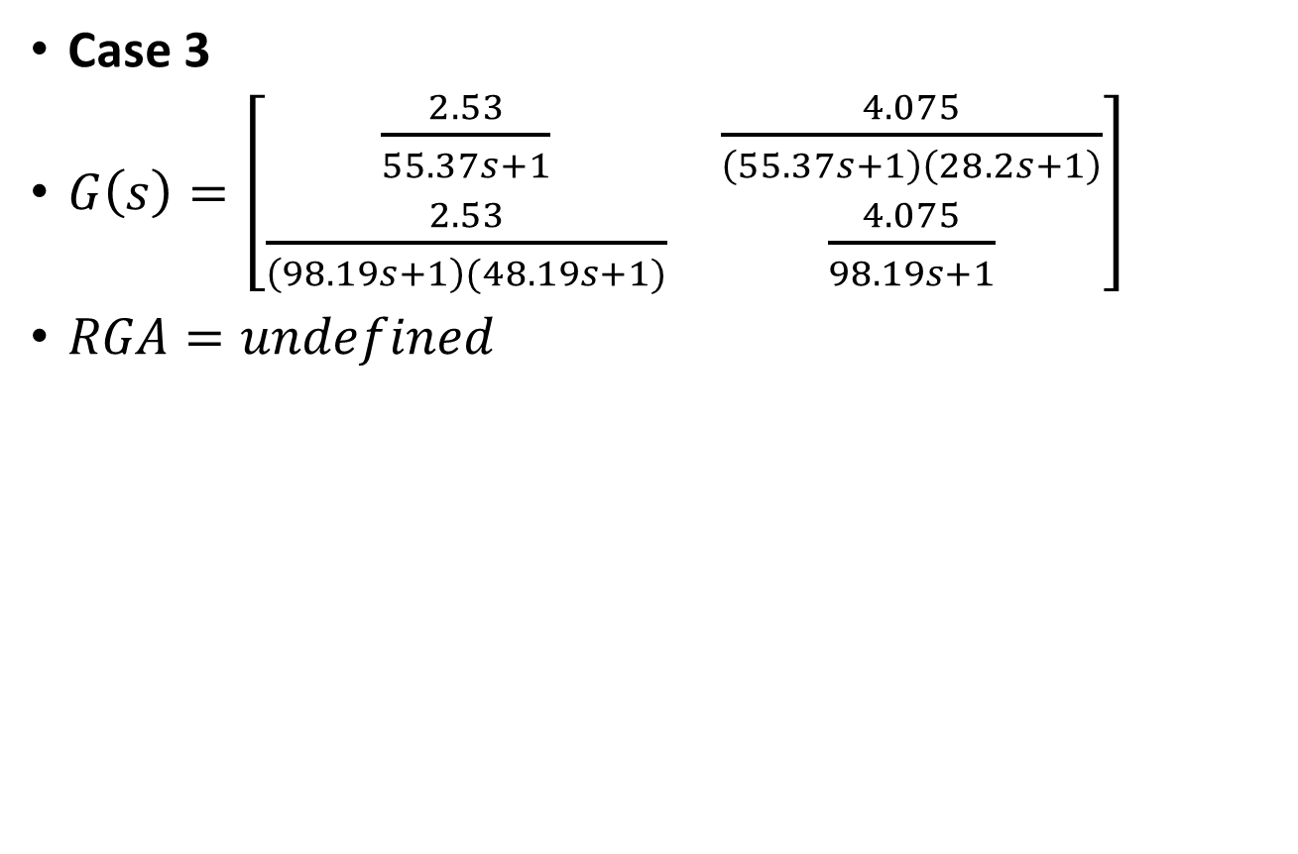
Quad Tank
Case 3
$G\left(s\right)=\left[\begin{matrix}\frac{2.53}{55.37s+1} & \frac{4.075}{\left(55.37s+1\right)\left(28.2s+1\right)} \\ \frac{2.53}{\left(98.19s+1\right)(48.19s+1)} & \frac{4.075}{98.19s+1}\end{matrix}\right]$
$RGA=undefined$

Slide 46
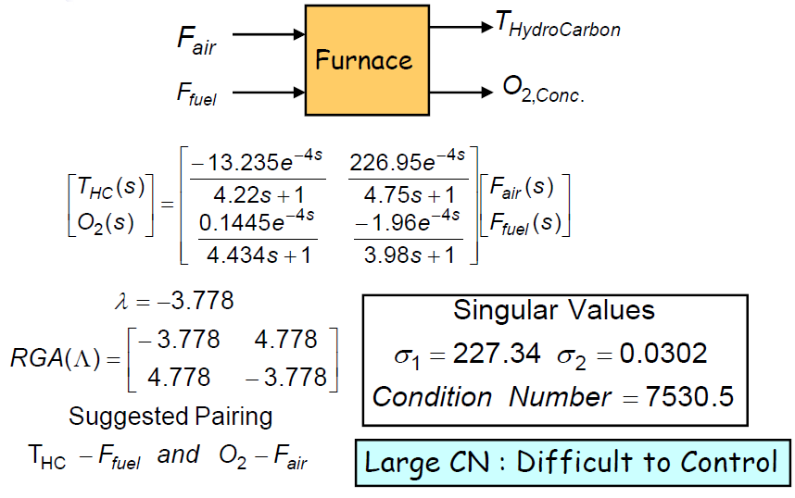
Furnace Control

Slide 47
4-Component Distillation Column

Slide 48
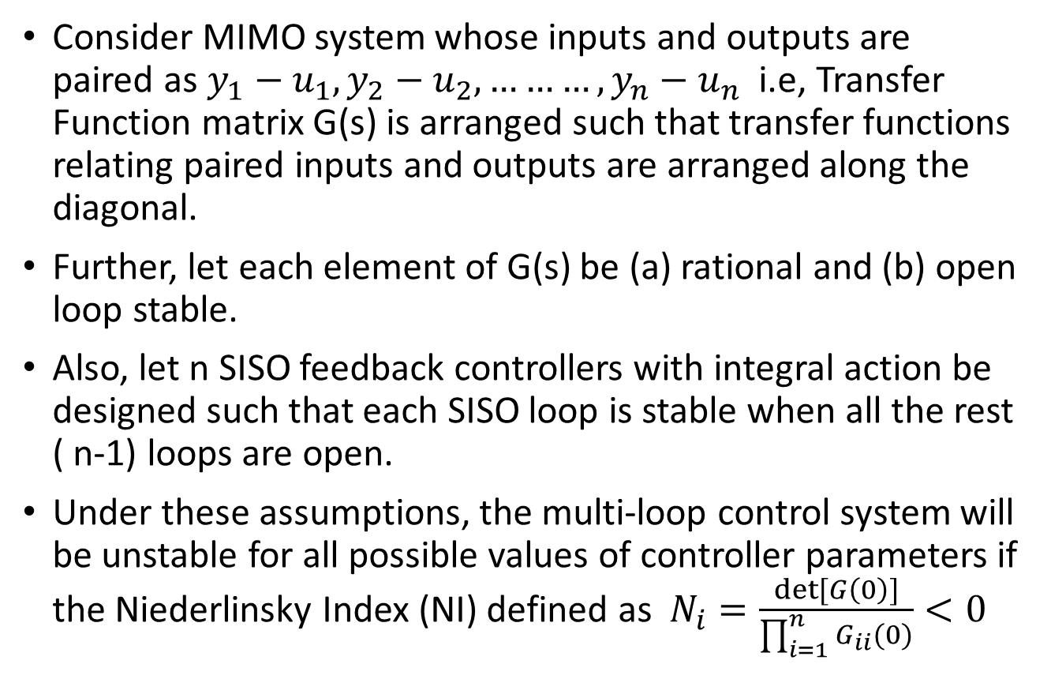
Niederlinsky Index
Consider MIMO system whose inputs and outputs are paired as $y_{1}−u_{1}, y_{2}−u_{2},………,y_{n}−u_{n}$ i.e, Transfer Function matrix G(s) is arranged such that transfer functions relating paired inputs and outputs are arranged along the diagonal.
Further, let each element of G(s) be (a) rational and (b) open loop stable.
Also, let n SISO feedback controllers with integral action be designed such that each SISO loop is stable when all the rest ( n-1) loops are open.
Under these assumptions, the multi-loop control system will be unstable for all possible values of controller parameters if the Niederlinsky Index (NI) defined as $N_{i}=\frac{det⁡[G\left(0\right)]}{\prod_{i=1}^{n}{G_{ii}(0)}}<0$

Slide 49
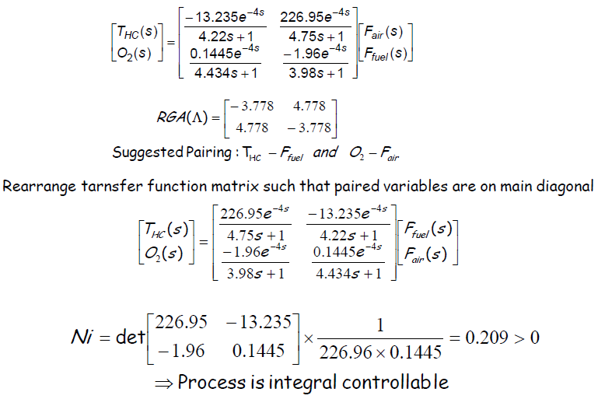
Furnace Control

Slide 50
Multi-Loop PID Control
After selection of loop pairings with minimum interactions, one can design controllers for individual loops.
Presence of interaction and retaliatory effects from other loops may require that the controller be detuned for acceptable performance.
BLT Detuning method
Sequential Loop Tuning
Independent Loop Tuning

Slide 51
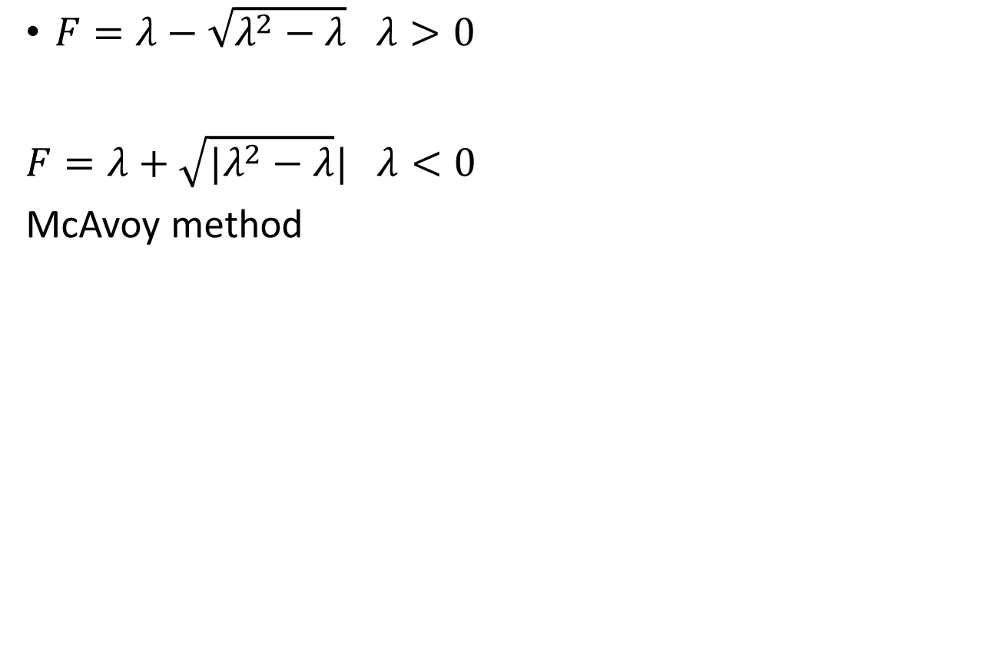
$F=λ−\sqrt{λ^{2}−λ}$ $λ>0$
$F=λ+\sqrt{|λ^{2}−λ}|$ $λ<0$
McAvoy method

Slide 52
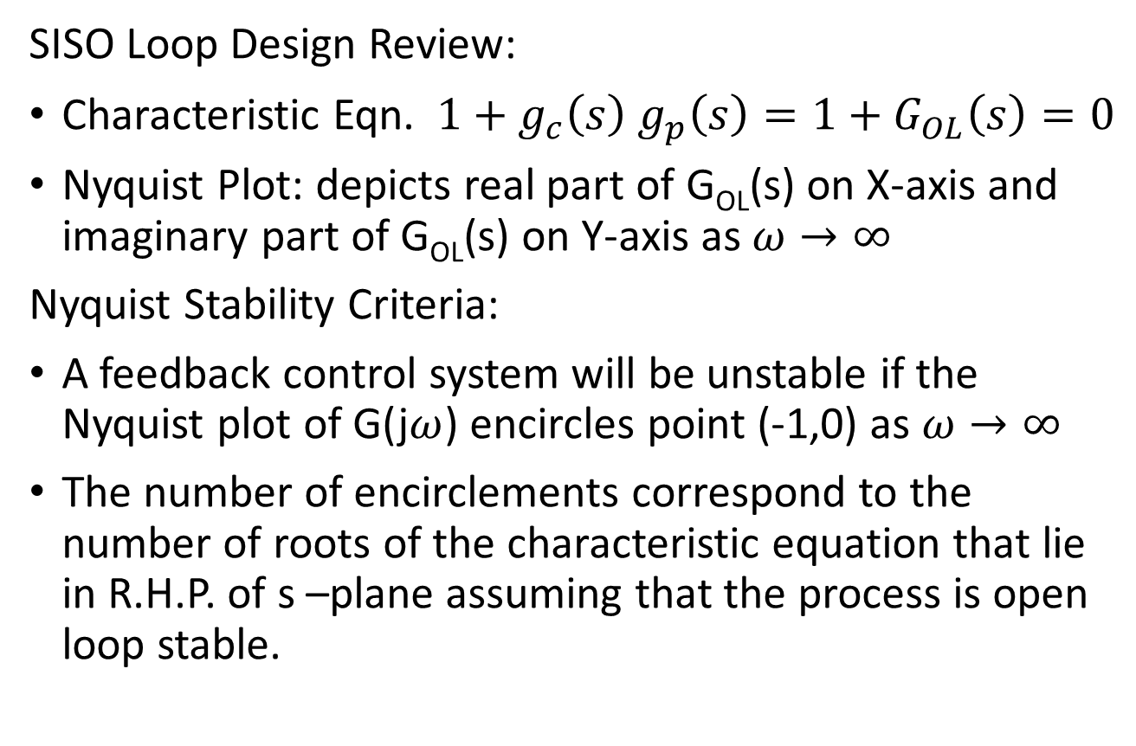
Biggest Log Modulus Tuning (BLT)
SISO Loop Design Review:
Characteristic Eqn. $1+g_{c}\left(s\right) g_{p}\left(s\right)=1+G_{OL}\left(s\right)=0$
Nyquist Plot: depicts real part of G_{OL}(s) on X-axis and imaginary part of G_{OL}(s) on Y-axis as $ω→∞$
Nyquist Stability Criteria:
A feedback control system will be unstable if the Nyquist plot of G(j$ω$) encircles point (-1,0) as $ω→∞$
The number of encirclements correspond to the number of roots of the characteristic equation that lie in R.H.P. of s –plane assuming that the process is open loop stable.

Slide 53
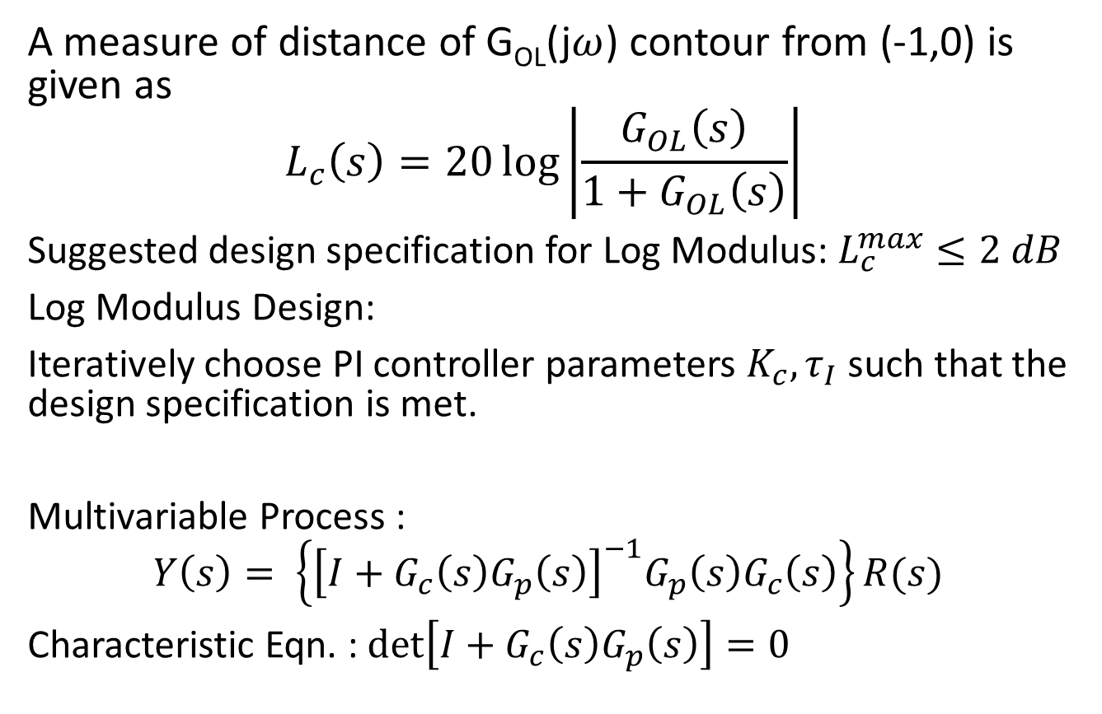
BLT Method
A measure of distance of G_{OL}(j$ω$) contour from (-1,0) is given as
$$L_{c}\left(s\right)=20\log\left|\frac{G_{OL}\left(s\right)}{1+G_{OL}\left(s\right)}\right|$$
Suggested design specification for Log Modulus: $L_{c}^{max}≤2 dB$
Log Modulus Design:
Iteratively choose PI controller parameters $K_{c}, τ_{I}$ such that the design specification is met.
Multivariable Process :
$$Y\left(s\right)= \left\{{\left[I+G_{c}\left(s\right)G_{p}\left(s\right)\right]}^{−1}G_{p}\left(s\right)G_{c}\left(s\right)\right\}R(s)$$
Characteristic Eqn. : $\det\left[I+G_{c}\left(s\right)G_{p}\left(s\right)\right]=0$

Slide 54
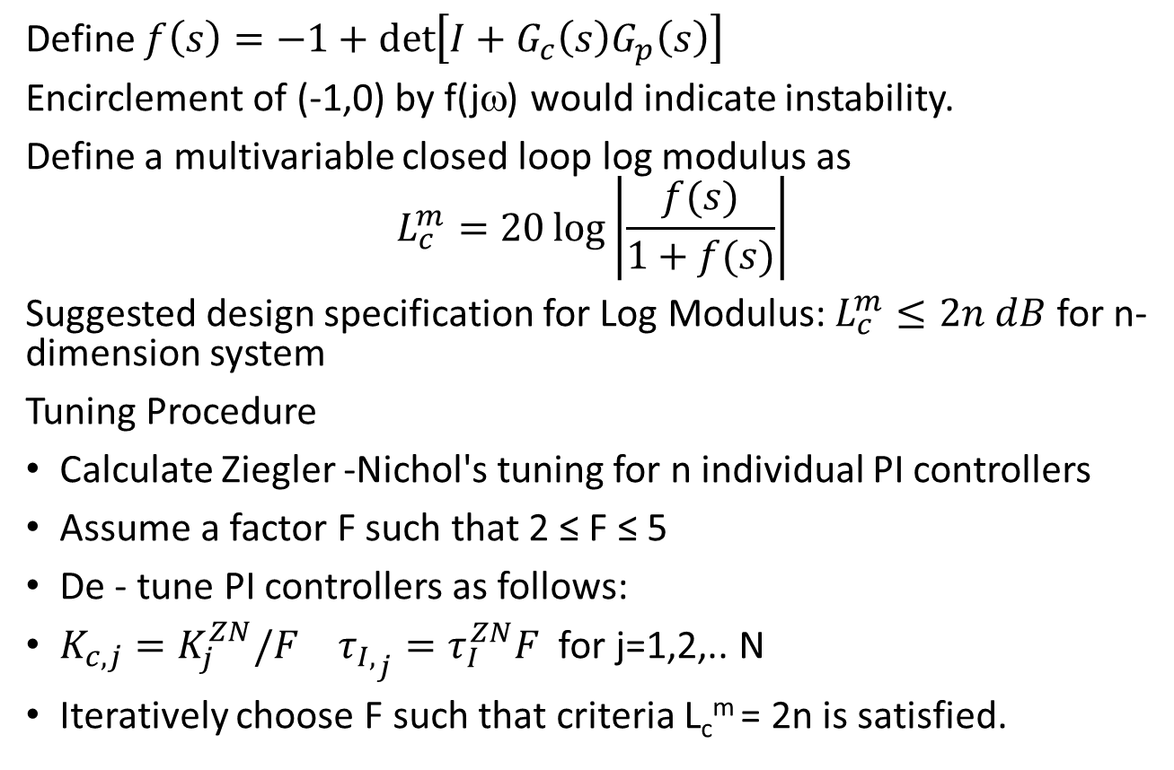
BLT Method
Define $f\left(s\right)=−1+\det\left[I+G_{c}\left(s\right)G_{p}\left(s\right)\right]$
Encirclement of (-1,0) by f(jω) would indicate instability.
Define a multivariable closed loop log modulus as
$$L_{c}^{m}=20\log\left|\frac{f(s)}{1+f(s)}\right|$$
Suggested design specification for Log Modulus: $L_{c}^{m}≤2n dB$ for n-dimension system
Tuning Procedure
Calculate Ziegler -Nichol's tuning for n individual PI controllers
Assume a factor F such that 2 ≤ F ≤ 5
De - tune PI controllers as follows:
$K_{c,j}=K_{j}^{ZN}/F$ ${τ_{I,}}_{j}=τ_{I}^{ZN}F$ for j=1,2,.. N
Iteratively choose F such that criteria L_{c}^{m} = 2n is satisfied.

Slide 55
BLT: Example

Slide 56
BLT: Example

Slide 57
BLT: Example

Slide 58
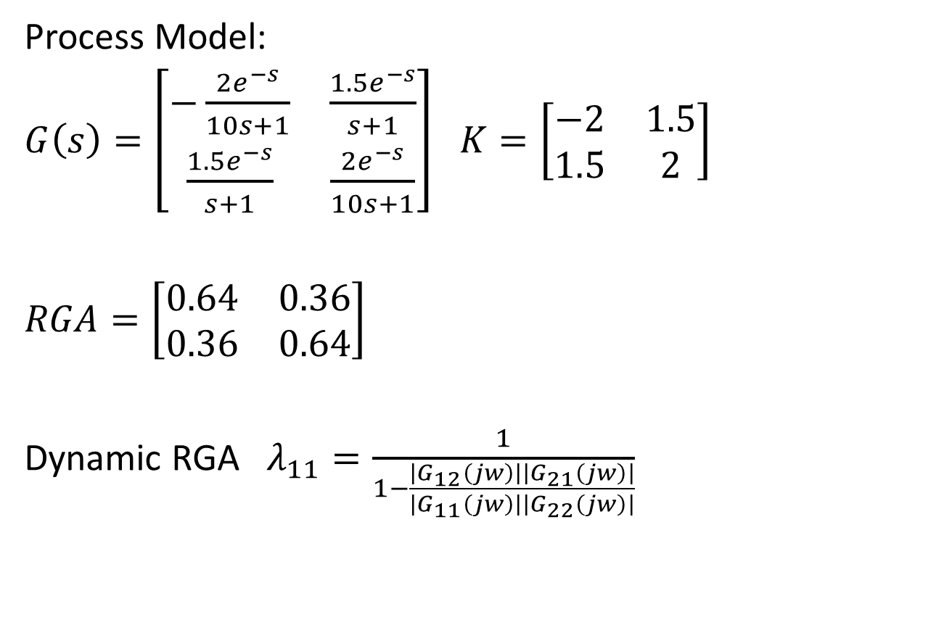
Dynamic RGA
Process Model:
$G\left(s\right)=\left[\begin{matrix}−\frac{2e^{−s}}{10s+1} & \frac{1.5e^{−s}}{s+1} \\ \frac{1.5e^{−s}}{s+1} & \frac{2e^{−s}}{10s+1}\end{matrix}\right]$ $K=\left[\begin{matrix}−2 & 1.5 \\ 1.5 & 2\end{matrix}\right]$
$RGA=\left[\begin{matrix}0.64 & 0.36 \\ 0.36 & 0.64\end{matrix}\right]$
Dynamic RGA $λ_{11}=\frac{1}{1−\frac{\left|G_{12}\left(jw\right)\right|\left|G_{21}\left(jw\right)\right|}{\left|G_{11}\left(jw\right)\right|\left|G_{22}\left(jw\right)\right|}}$

Slide 59
Principles of Decoupling

Slide 60
Block Diagram : Quad Tank

Slide 61
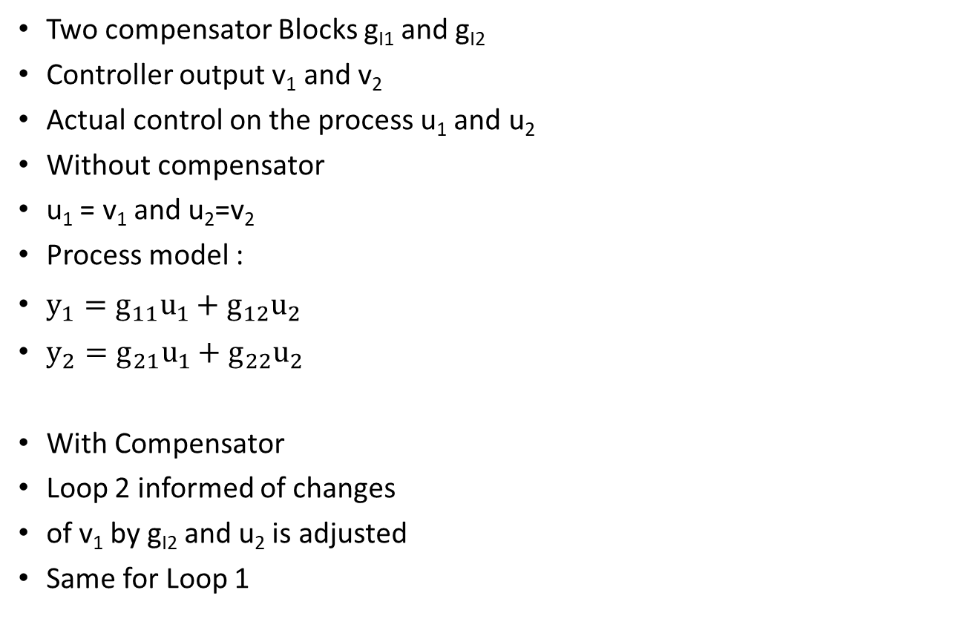
Simplified Decoupling
Two compensator Blocks g_{I1} and g_{I2}
Controller output v₁ and v₂
Actual control on the process u₁ and u₂
Without compensator
u₁ = v₁ and u₂=v₂
Process model :
$y_{1}=g_{11}u_{1}+g_{12}u_{2}$
$y_{2}=g_{21}u_{1}+g_{22}u_{2}$
With Compensator
Loop 2 informed of changes
of v₁ by g_{I2} and u₂ is adjusted
Same for Loop 1

Slide 62
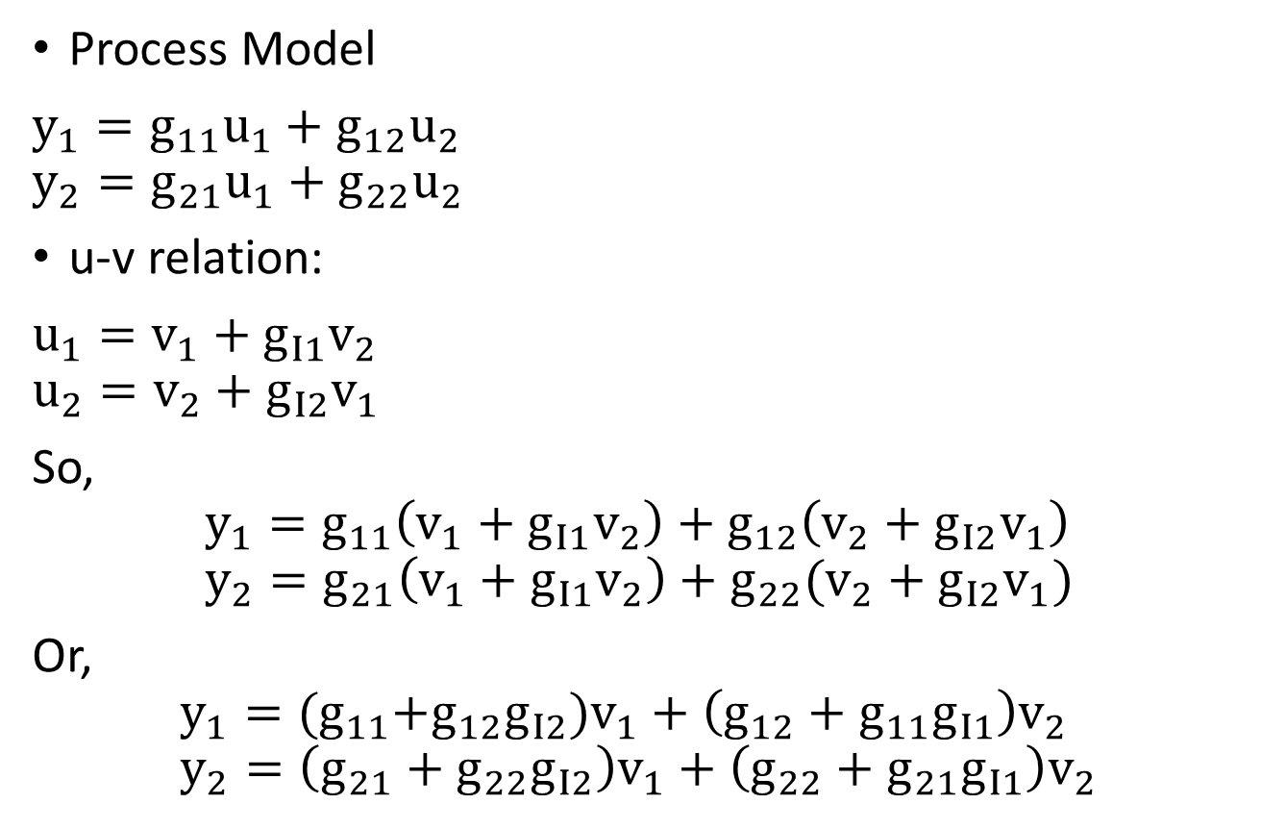
Simplified Decoupler Design
Process Model
$y_{1}=g_{11}u_{1}+g_{12}u_{2}$ $y_{2}=g_{21}u_{1}+g_{22}u_{2}$
u-v relation:
$u_{1}=v_{1}+g_{I1}v_{2}$ $u_{2}=v_{2}+g_{I2}v_{1}$
So,
$$y_{1}=g_{11}\left(v_{1}+g_{I1}v_{2}\right)+g_{12}\left(v_{2}+g_{I2}v_{1}\right) \\ y_{2}=g_{21}\left(v_{1}+g_{I1}v_{2}\right)+g_{22}(v_{2}+g_{I2}v_{1})$$
Or,
$$y_{1}={(g}_{11}+g_{12}g_{I2})v_{1}+\left(g_{12}+g_{11}g_{I1}\right)v_{2} \\ y_{2}=\left(g_{21}+g_{22}g_{I2}\right)v_{1}+\left(g_{22}+g_{21}g_{I1}\right)v_{2}$$

Slide 63
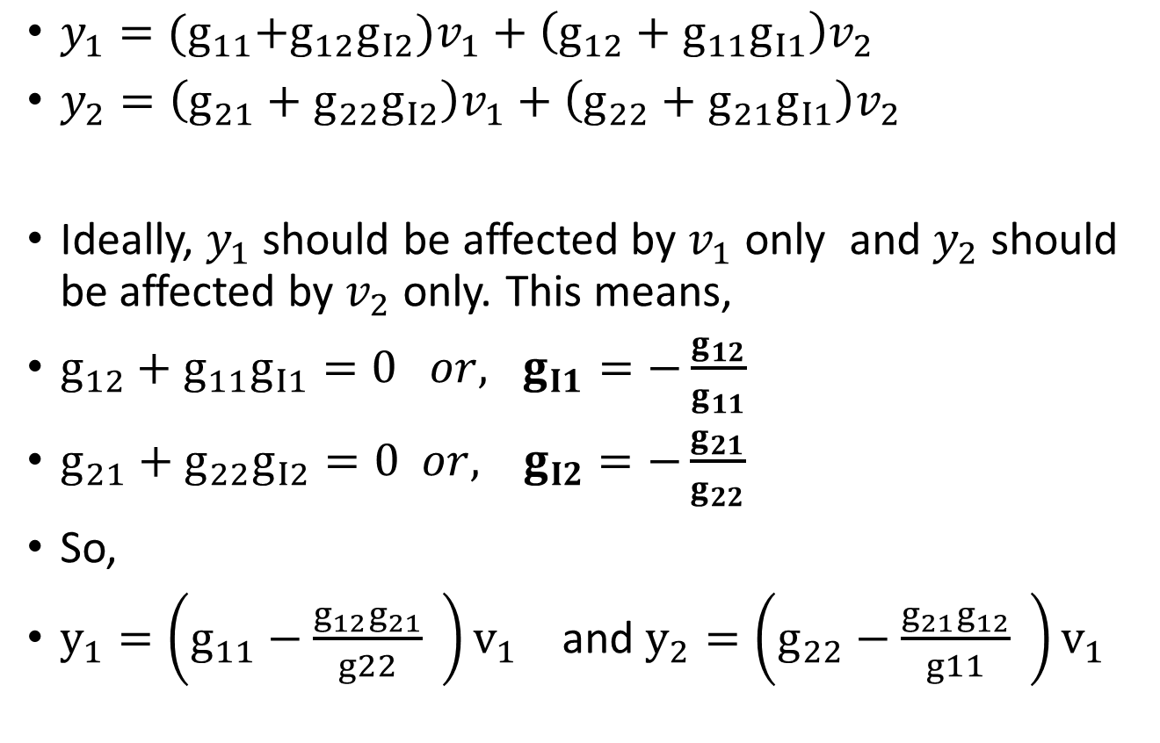
Simplified Decoupler Design
$y_{1}={(g}_{11}+g_{12}g_{I2})v_{1}+\left(g_{12}+g_{11}g_{I1}\right)v_{2}$
$y_{2}=\left(g_{21}+g_{22}g_{I2}\right)v_{1}+\left(g_{22}+g_{21}g_{I1}\right)v_{2}$
Ideally, $y_{1}$ should be affected by $v_{1}$ only and $y_{2}$ should be affected by $v_{2}$ only. This means,
$g_{12}+g_{11}g_{I1}=0 or, g_{I1}=−\frac{g_{12}}{g_{11}}$
$g_{21}+g_{22}g_{I2}=0 or, { g}_{I2}=−\frac{g_{21}}{g_{22}}$
So,
$y_{1}=\left(g_{11}−\frac{g_{12}g_{21}}{g22} \right)v_{1}$ and $y_{2}=\left(g_{22}−\frac{g_{21}g_{12}}{g11} \right)v_{1}$

Slide 64
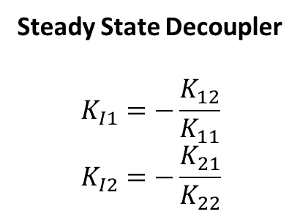
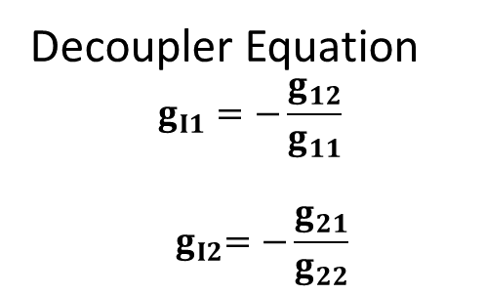
Simplified Decoupler Design
Decoupler Equation
$$g_{I1}=−\frac{g_{12}}{g_{11}}$$
$${ g}_{I2}=−\frac{g_{21}}{g_{22}}$$
Steady State Decoupler
$$K_{I1}=−\frac{K_{12}}{K_{11}} \\ K_{I2}=−\frac{K_{21}}{K_{22}}$$

Slide 65
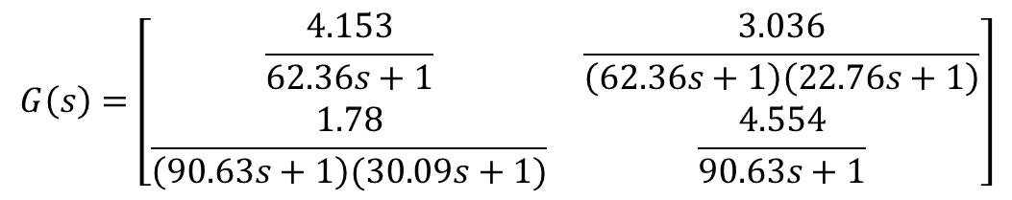
Quad tank : Decoupler Design
$$G\left(s\right)=\left[\begin{matrix}\frac{4.153}{62.36s+1} & \frac{3.036}{\left(62.36s+1\right)\left(22.76s+1\right)} \\ \frac{1.78}{\left(90.63s+1\right)(30.09s+1)} & \frac{4.554}{90.63s+1}\end{matrix}\right]$$
Steady State Decoupler : $K_{I1}=−\frac{3.036}{4.153}=−0.731$ $K_{I2}=−\frac{1.78}{4.554}=−0.391$

Slide 66
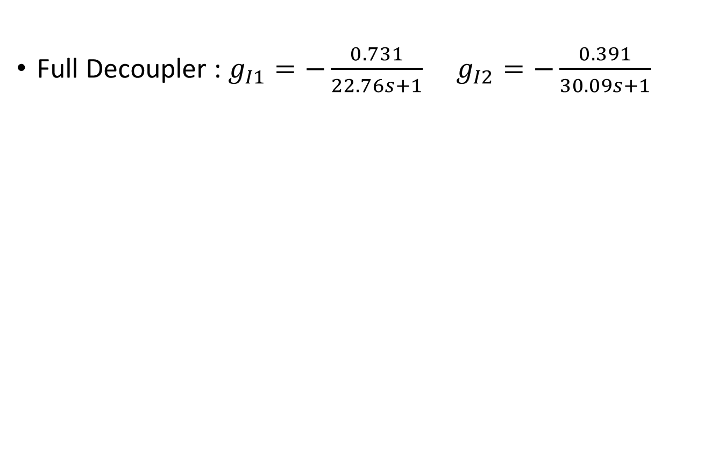
Quad tank : Decoupler Design
Full Decoupler : $g_{I1}=−\frac{0.731}{22.76s+1}$ $g_{I2}=−\frac{0.391}{30.09s+1}$

Slide 67
Example: Wood Berry Distillation Column

Slide 68
Difficulties in simplied Decoupler design

Slide 69
Generalized Decoupler Design

Slide 70
Example: Wood Berry Distillation Column

Slide 71
Steady State Decoupler Design

Slide 72
Example: Wood Berry Distillation Column

Slide 73
Simplified Vs Generalized Decoupler

Slide 74
Challenges in Decoupler Design

Slide 75
Challenges in Decoupler Design

Slide 76
Example Problem

Slide 77
Example Problem
Alternate Solution

Slide 78
Partial Decoupling

Slide 79
Partial Decoupling Example

